Slide 1

VisionAI : Smart Image Analysis with ESP32-CAM
NAME OF THE SUPERVISOR
CANDIDATE DETAILS
INTERNAL GUIDE:
Dr. S. Chandravadhana M.E., Ph.D
Professor
Dept. of Mechatronics Engineering
HEAD OF THE DEPARTMENT:
Dr. S. Chandravadhana M.E., Ph.D
Professor
Dept. of Mechatronics Engineering
DEPARTMENT OF MECHATRONICS ENGINEERING
Member 1 : Kishore G (22MT029)
Member 2 : Melbin MC (22MT032)
CHENNAI INSTITUTE OF TECHNOLOGY
CHENNAI-600069

Slide 2
INTRODUCTION
Keeping Track of weather is a very critical operation and needs high speed and coordination among weather trackers and reporting teams. A constant coordination is required between both teams to collect and constantly transmit weather data to reporting teams. This data is viewed by normal public to plan their day, ships and sea route planning, fishing department, disaster relief department and more.
The system makes use of Temperature and humidity sensor to sense environment temperature and humidity levels. A rain sensor is used to detect rain. Also we use an LCD display to display the data and system status. This system is powered by Arduino for sensor detection and Raspberry Pi for Data Transmission over the internet.
The Arduino controller monitors all the sensors to check their levels and transmit the data over to the raspberry pi controller. The Raspberry Pi controller receives data from the Arduino and transmits over Wi-Fi. The raspberry pi is connected to internet using inbuilt Wi-Fi module. The Pi sends data over to IOT Gecko platform IP for storing.

Slide 3
PROBLEM STATEMENT
Existing weather monitoring systems focus primarily on real-time data collection, lacking advanced AI-based forecasting features, which limits their usefulness for anticipating future weather events
Inaccurate sensor readings due to calibration problems compromise the reliability of the collected data, making it difficult to provide consistent and precise weather insights
Traditional weather monitoring systems often struggle with scalability, limiting their deployment across larger geographic areas or integration into widespread IoT networks
Many weather systems consume significant power, especially in remote or resource-limited environments, where energy efficiency is crucial for long-term, continuous monitoring

Slide 4
OBJECTIVES
The objective of this project is to develop an IoT-based Weather Reporting System using Arduino . This system will be capable of:
Real-time Data Collection: Measuring key weather parameters such as temperature, humidity, atmospheric pressure, and light intensity using sensors connected to Arduino.
Data Processing and Transmission: Using Raspberry Pi to collect data from the Arduino, process it, and transmit it to a cloud server or database for storage and further analysis.
Remote Monitoring and Reporting: Allowing users to access weather data remotely through a web or mobile interface, enabling real-time monitoring and decision-making.
Scalability and Flexibility: Designing the system to be scalable, allowing additional sensors or modules to be added as needed, and providing flexibility in deployment locations.
Cost-effectiveness and Ease of Use: Creating a solution that is affordable, easy to assemble, and user-friendly, making it accessible to a wide range of users, including hobbyists, farmers, and researchers.

Slide 5
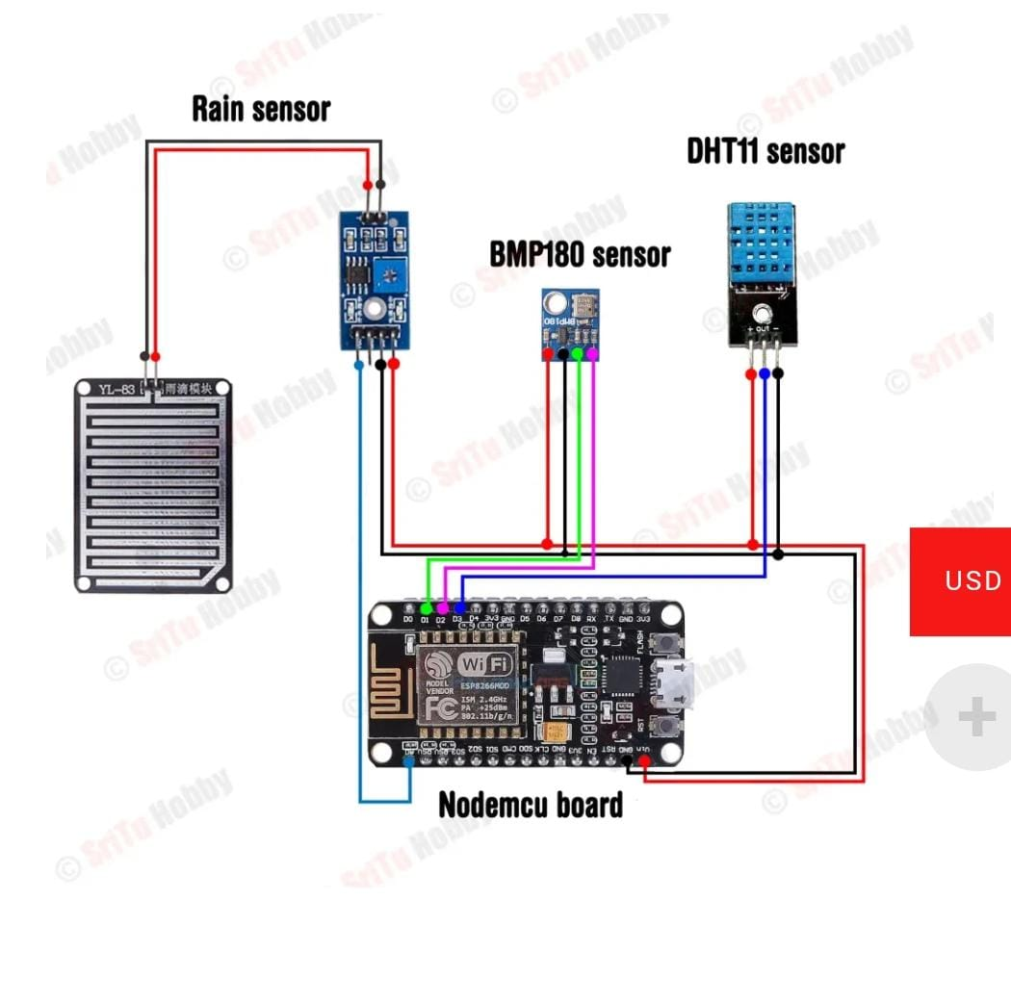
METHODOLOGY

Slide 6
METHODOLOGY
The methodology for developing the Weather Monitoring System using ESP8266 and AI included several phases. It began with a requirement analysis to identify key environmental parameters: temperature, humidity, atmospheric pressure, rainfall, and light intensity. The system architecture integrated sensors, the ESP8266 microcontroller, cloud storage, AI algorithms, and a web interface for visualization

Slide 7
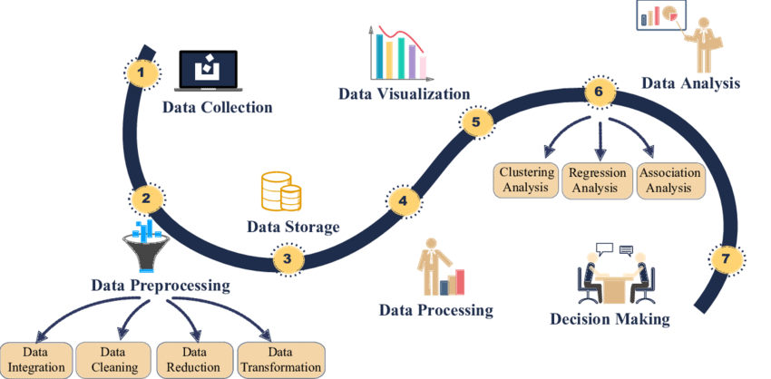
METHODOLOGY

Slide 8
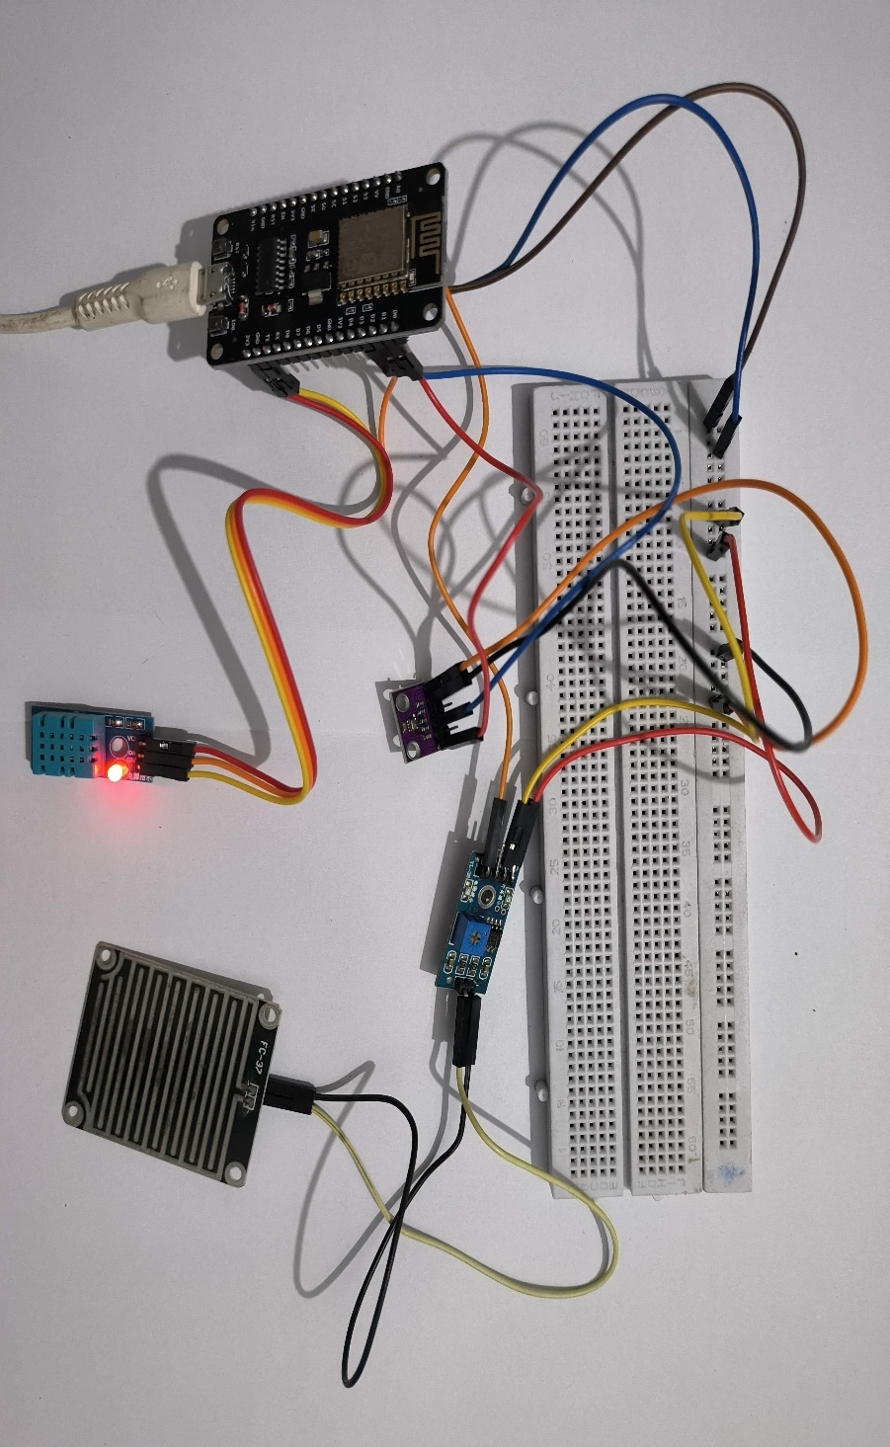
WORKING MODEL

Slide 9
COMPONENTS USED
Arduino Uno
Raspberry Pi
Rain Sensor
Temperature and Humidity Sensor
LCD Display
Regulatory Circuitry
Switches
LED’s
PCB Board
Resistors
Capacitors
Transistors
Cables and Connectors

Slide 10
ADVANTAGES
Real-Time Monitoring
Predictive Weather Forecasting
Cost-Effective
Wireless Data Transmission
Scalable Solution
Remote Access
Energy Efficient
User-Friendly Interface
Customizable Alerts
Enhanced Decision-Making

Slide 11
LITERATURE REVIEW
SL NO | PAPER TITLE | AUTHOR | DISCUSSION
1. | Development of IoT Based Weather Reporting System | A F Pauzi and M Z Hasan | Weather forecast these days is unpredictable too be exact because of the climate changes drastically over weather. In cause of that, Weather Reporting System is mostly used to monitor the continuously changing climatic and weather conditions over controlled areas likes house, industry, agriculture and etc. in real time monitoring.

Slide 12
THANK YOU

